Slide 1
Overview of classical ML: classification methods and decision trees
Decision Trees
Cong Ma
Notes:
\usepackage{mathtools} \newcommand\iidsim{\stackrel{\mathclap{iid}}{\sim}}
\DeclareMathOperator*{\argmin}{\arg\min}
\DeclareMathOperator*{\argmax}{\arg\max}

Slide 2
Outline
What’s a decision tree?
Regression tree:
How to grow a tree: decrease in squared error
How to prune a tree
How to predict given a tree
Classification tree
How to grow a tree: misclassification rate, information gain, Gini index
How to predict
Summary

Slide 3
Tree based methods
Divide the input space into a number of simple regions
Use simple prediction rules in each region

Slide 4
Adaptive feature selection
Prediction based on (a sequence of) decision rules

Slide 5
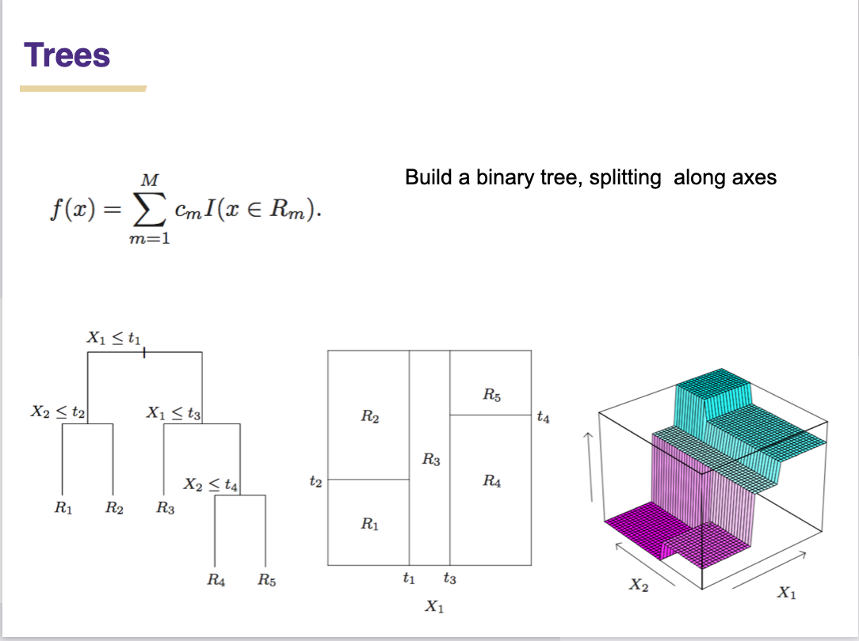
Regression trees

Slide 6
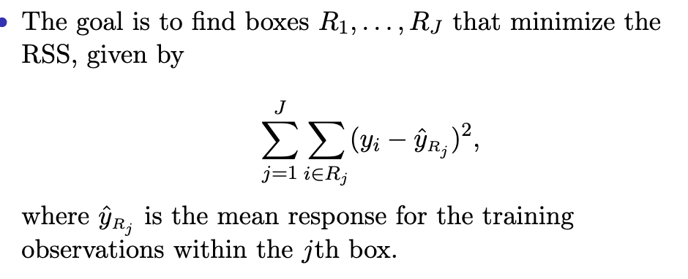
Goal

Slide 7
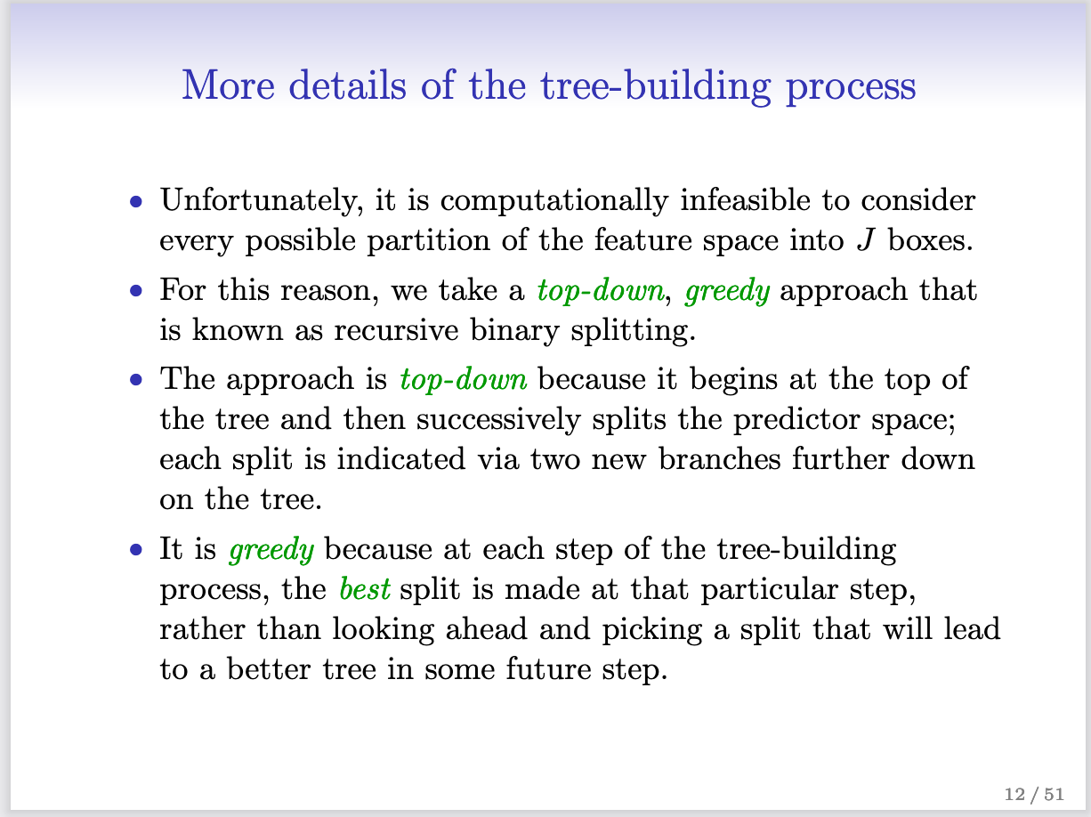

Slide 8
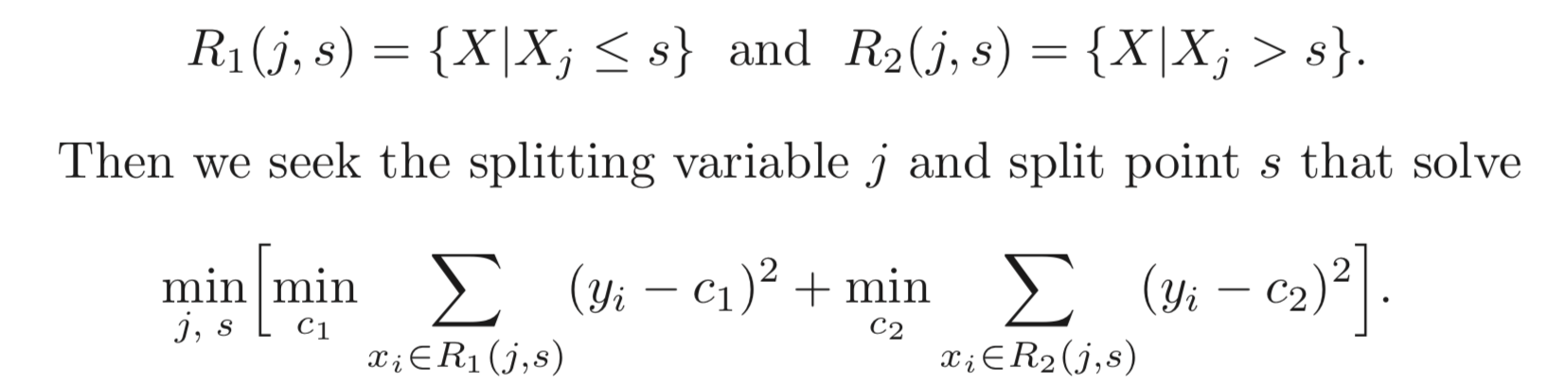
How to grow a regression tree

Slide 9
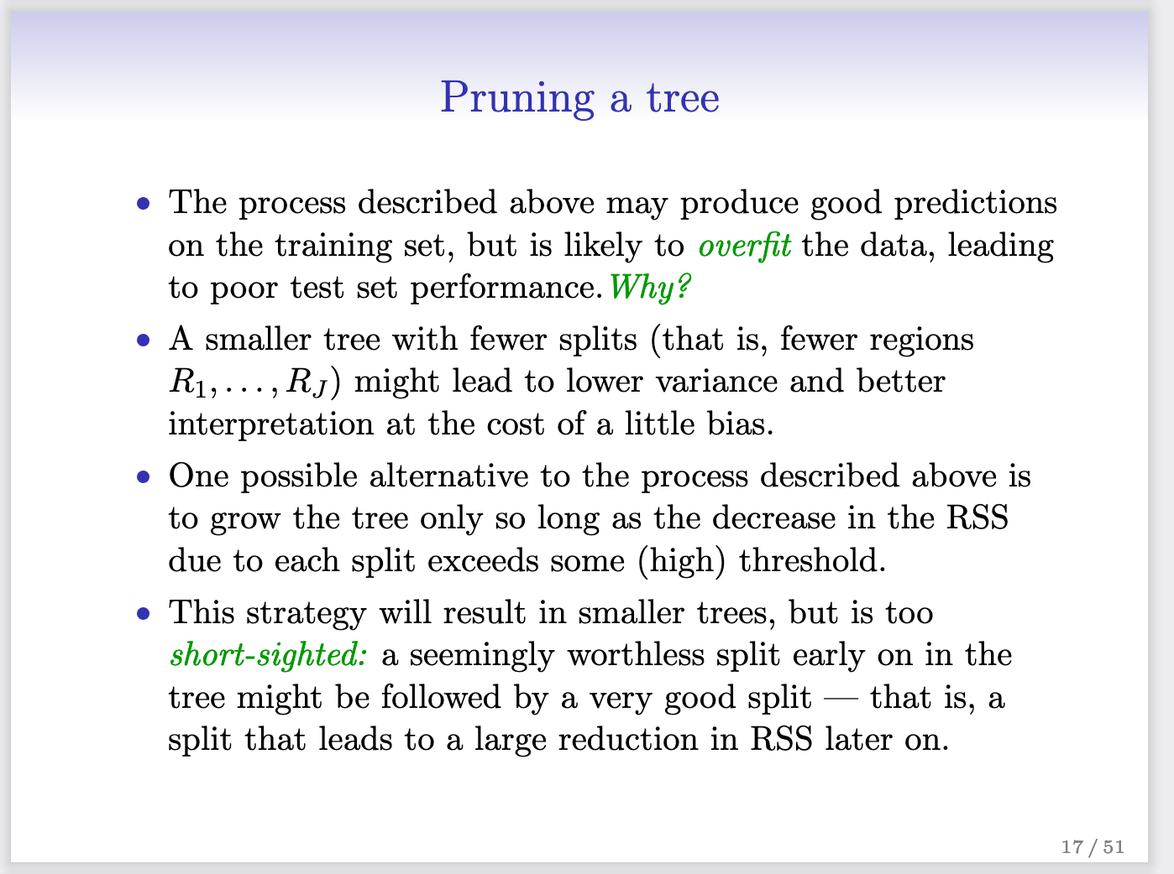

Slide 10
Tree pruning
Greedily grow the tree is prone to overfitting
Tree pruning phase
Searching over all trees and find the one with the best fit to data and smallest size
We can prune back tree branches (i.e. merge a pair of leaf nodes) recursively to choose the tree that minimizes the above objective
Due to the greedy nature for the growth phase, the combined growth + pruning process is not guaranteed to find the optimal tree
Notes:
\sum_{v \in \mathcal{T}} L(S_v)
\min_{\mathcal{T}} -\sum_{v \in \mathcal{T}} L(S_v) + \lambda |\mathcal{T}|

Slide 12
Classification tree
How to split a node?
How to predict in the end?

Slide 13
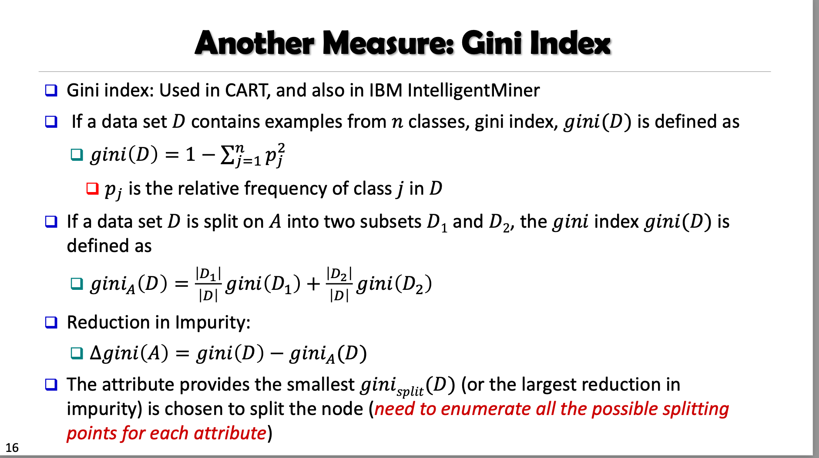

Slide 14
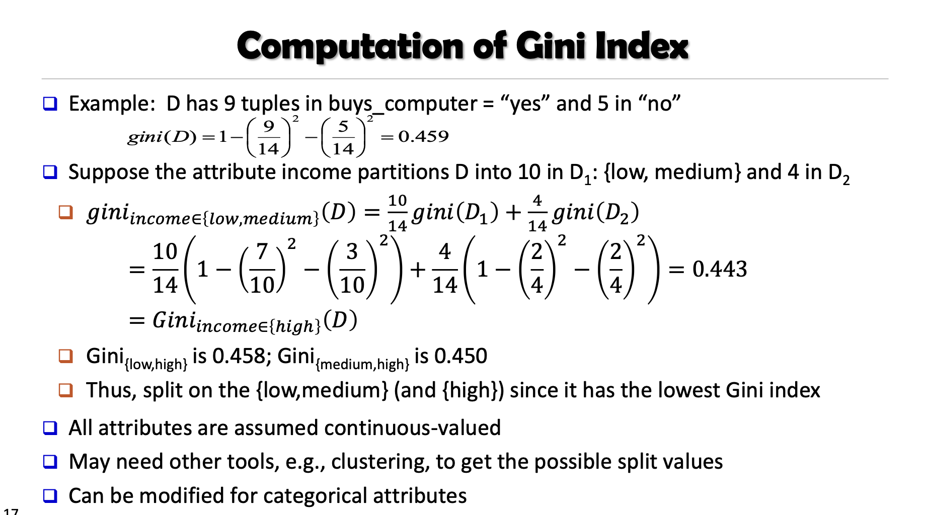

Slide 15
STAT 37710 / CMSC 35400 / CAAM 37710 Machine Learning
Bagging & Random Forests
Cong Ma
Notes:
\usepackage{mathtools} \newcommand\iidsim{\stackrel{\mathclap{iid}}{\sim}}
\DeclareMathOperator*{\argmin}{\arg\min}
\DeclareMathOperator*{\argmax}{\arg\max}

Slide 16
Recall: decision trees
Decision Trees are
low bias, high variance models
Unless you regularize a lot…
…but then often worse than Linear Models
highly non-linear
Can easily overfit
Different training samples can lead to very different trees

Slide 17
How to improve decision trees?
What’s the problem of decision tree?
Low bias but high variance
We’d like to keep the low bias, but decrease the variance
Key idea: build multiple trees and take the average
We know averaging reduces variance (Caveat!)

Slide 18
Average over multiple different datasets
Goal: reduces variance
Ideal setting:
many training sets D’
sample independently
train model using each D’
average predictions
P(x,y)
Person | Age | Male? | Height > 55”
James | 11 | 1 | 1
Jessica | 14 | 0 | 1
Alice | 14 | 0 | 1
Amy | 12 | 0 | 1
Bob | 10 | 1 | 1
Xavier | 9 | 1 | 0
Cathy | 9 | 0 | 1
Carol | 13 | 0 | 1
Eugene | 13 | 1 | 0
Rafael | 12 | 1 | 1
Dave | 8 | 1 | 0
Peter | 9 | 1 | 0
Henry | 13 | 1 | 0
Erin | 11 | 0 | 0
Rose | 7 | 0 | 0
Iain | 8 | 1 | 1
Paulo | 12 | 1 | 0
Frank | 9 | 1 | 1
Jill | 13 | 0 | 0
Leon | 10 | 1 | 0
Sarah | 12 | 0 | 0
Gena | 8 | 0 | 0
Patrick | 5 | 1 | 1
D’
Person | Age | Male? | Height > 55”
Alice | 14 | 0 | 1
Bob | 10 | 1 | 1
Carol | 13 | 0 | 1
Dave | 8 | 1 | 0
Erin | 11 | 0 | 0
Frank | 9 | 1 | 1
Gena | 8 | 0 | 0
“Bagging Predictors” [Leo Breiman, 1994]
http://statistics.berkeley.edu/sites/default/files/tech-reports/421.pdf
Notes:
Start with a root node
S_{v_0}^{(j,\tau)} = \{(\mathbf{x}_i, y_i) \in S_v\}: x_{ij} < \tau\}
S_{v_1}^{(j,\tau)} = \{(\mathbf{x}_i, y_i) \in S_v\}: x_{ij} \geq \tau\}

Slide 19
Bagging
Goal: reduces variance
In practice:
fixed training set D
Resample D’ with replacement from D
train model using each D’
average predictions
D
Person | Age | Male? | Height > 55”
James | 11 | 1 | 1
Jessica | 14 | 0 | 1
Alice | 14 | 0 | 1
Amy | 12 | 0 | 1
Bob | 10 | 1 | 1
Xavier | 9 | 1 | 0
Cathy | 9 | 0 | 1
Carol | 13 | 0 | 1
Eugene | 13 | 1 | 0
Rafael | 12 | 1 | 1
Dave | 8 | 1 | 0
Peter | 9 | 1 | 0
Henry | 13 | 1 | 0
Erin | 11 | 0 | 0
Rose | 7 | 0 | 0
Iain | 8 | 1 | 1
Paulo | 12 | 1 | 0
Frank | 9 | 1 | 1
Jill | 13 | 0 | 0
Leon | 10 | 1 | 0
Sarah | 12 | 0 | 0
Gena | 8 | 0 | 0
Patrick | 5 | 1 | 1
D’
Person | Age | Male? | Height > 55”
Alice | 14 | 0 | 1
Bob | 10 | 1 | 1
Carol | 13 | 0 | 1
Dave | 8 | 1 | 0
Erin | 11 | 0 | 0
Frank | 9 | 1 | 1
Gena | 8 | 0 | 0
“Bagging Predictors” [Leo Breiman, 1994]
http://statistics.berkeley.edu/sites/default/files/tech-reports/421.pdf
Notes:
Start with a root node
S_{v_0}^{(j,\tau)} = \{(\mathbf{x}_i, y_i) \in S_v\}: x_{ij} < \tau\}
S_{v_1}^{(j,\tau)} = \{(\mathbf{x}_i, y_i) \in S_v\}: x_{ij} \geq \tau\}

Slide 20
Bagging = Bootstrap Aggregating
Learns a predictor by aggregating the predictors learned over multiple random draws (bootstrap samples) from the training data
A bootstrap sample of size m from is
where each (x_{i}’, y_{i}’) is drawn uniformly at random from D (with replacement)
Notes:
Start with a root node
S_{v_0}^{(j,\tau)} = \{(\mathbf{x}_i, y_i) \in S_v\}: x_{ij} < \tau\}
S_{v_1}^{(j,\tau)} = \{(\mathbf{x}_i, y_i) \in S_v\}: x_{ij} \geq \tau\}

Slide 21
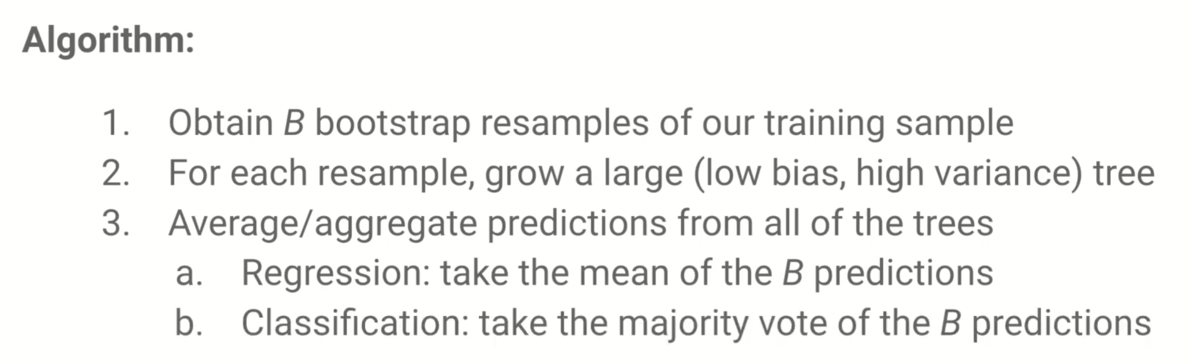
Bagged trees

Slide 22
Aggregating weak predictors
Imagine we have a model we can fit to the training data to produce a predictor that we use to predict E(Y|X=x)
E.g. a decision tree or logistic regression
With bagging, we
compute B different bootstrap samples
learn a predictor for each one
aggregate the predictors to form the target predictor

Slide 23
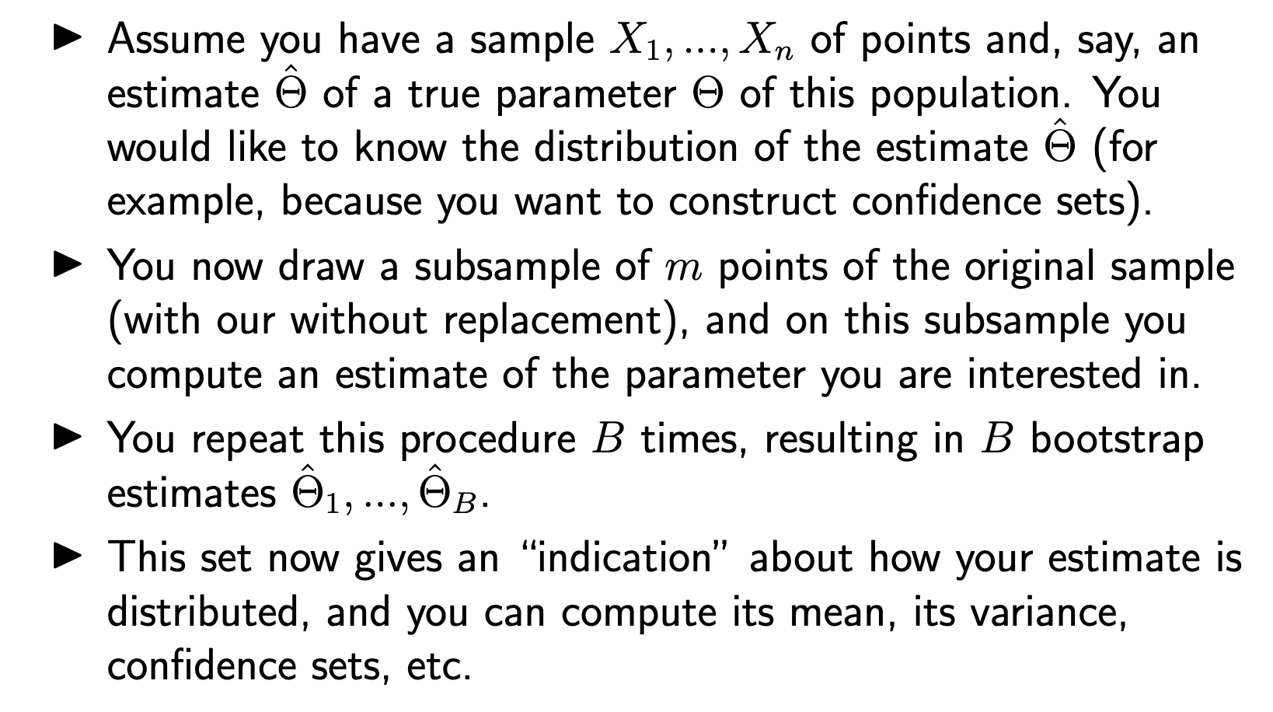
Bootstrap

Slide 24
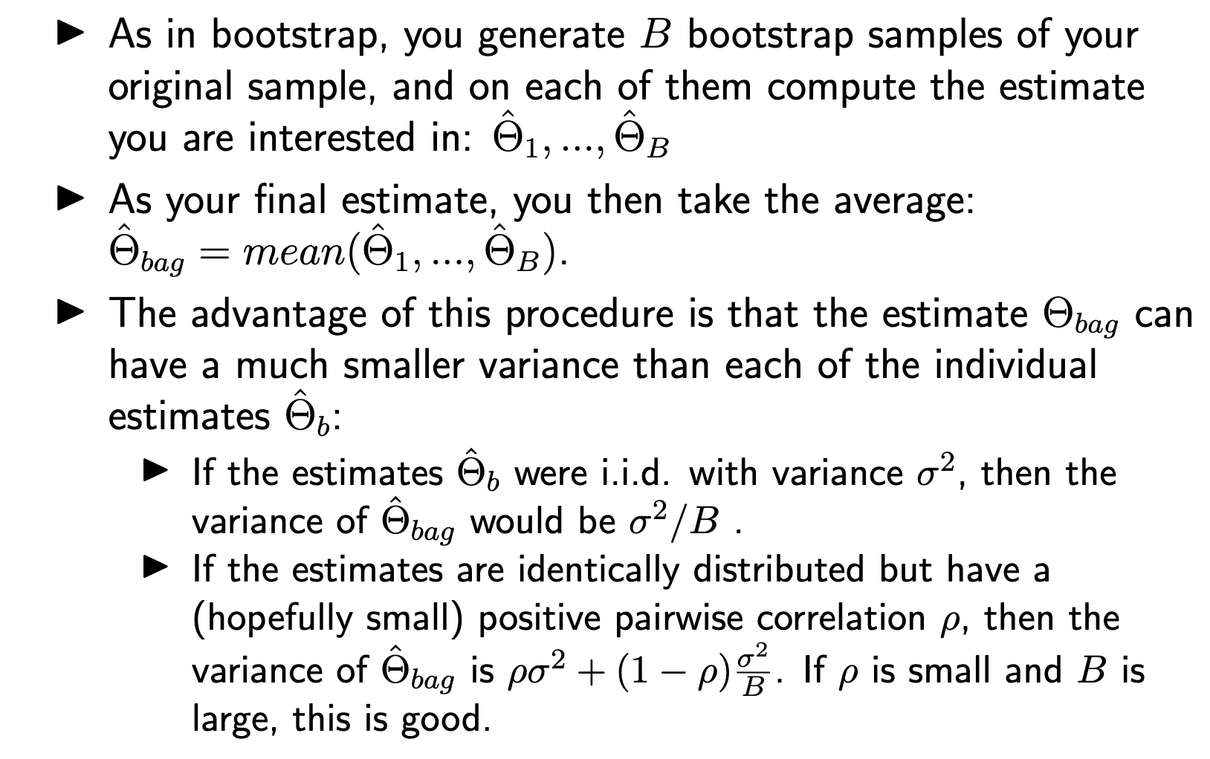
Bagging

Slide 25
Decorrelate the trees
Key: we’d like “diversity” in the trees we build, or further decorrelate the trees we build
Use random features in splitting the nodes!

Slide 26
Random Forests
Goal: reduce variance
Bagging can only do so much
Resampling training data
Random Forests: sample data & features!
Sample S’
Train DT
At each node, sample features
Average predictions

Slide 27
Random Forests
Extension of bagging to sampling features
Generate bootstrap D’ from D
Train DT top-down on D’
Each node, sample subset of features for splitting
Can also sample a subset of splits as well
Average predictions of all DTs
“Random Forests – Random Features” [Leo Breiman, 1997]
http://oz.berkeley.edu/~breiman/random-forests.pdf

Slide 28
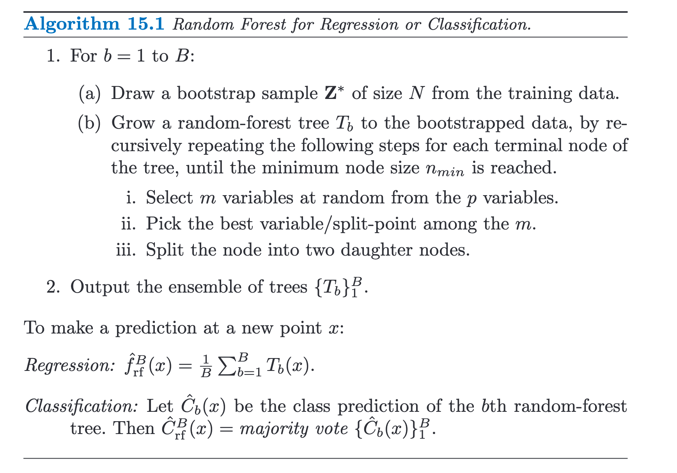
Algorithm for random forest

Slide 29
Better
Random Forests
Average performance over many datasets
Random Forests perform the best
“An Empirical Evaluation of Supervised Learning in High Dimensions”
Caruana, Karampatziakis & Yessenalina, ICML 2008

Slide 30
STAT 37710 / CMSC 35400 / CAAM 37710 Machine Learning
Boosting
Cong Ma
Notes:
\usepackage{mathtools} \newcommand\iidsim{\stackrel{\mathclap{iid}}{\sim}}
\DeclareMathOperator*{\argmin}{\arg\min}
\DeclareMathOperator*{\argmax}{\arg\max}

Slide 31
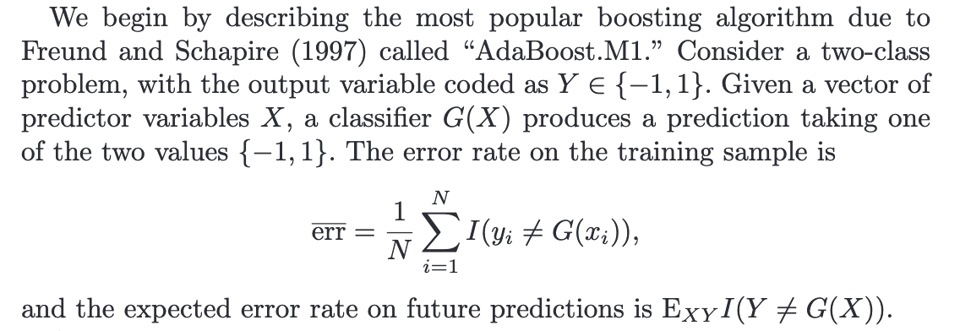
AdaBoost for binary classification
Purpose of Boosting: sequentially apply the weak classification algorithm to repeatedly modified versions of the data, thereby producing a sequence of weak classifiers

Slide 32
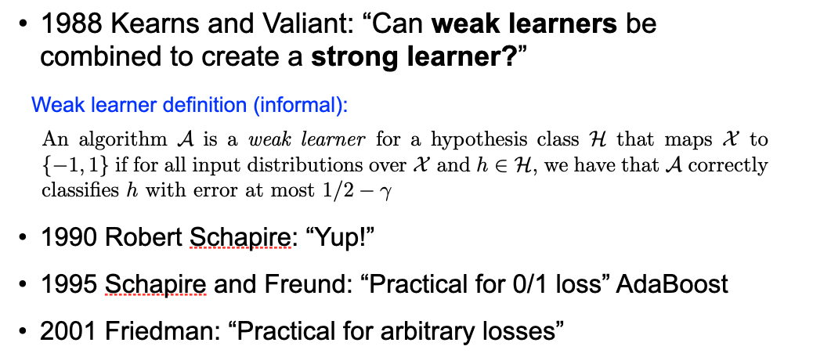
Weak learner to strong learner?

Slide 33
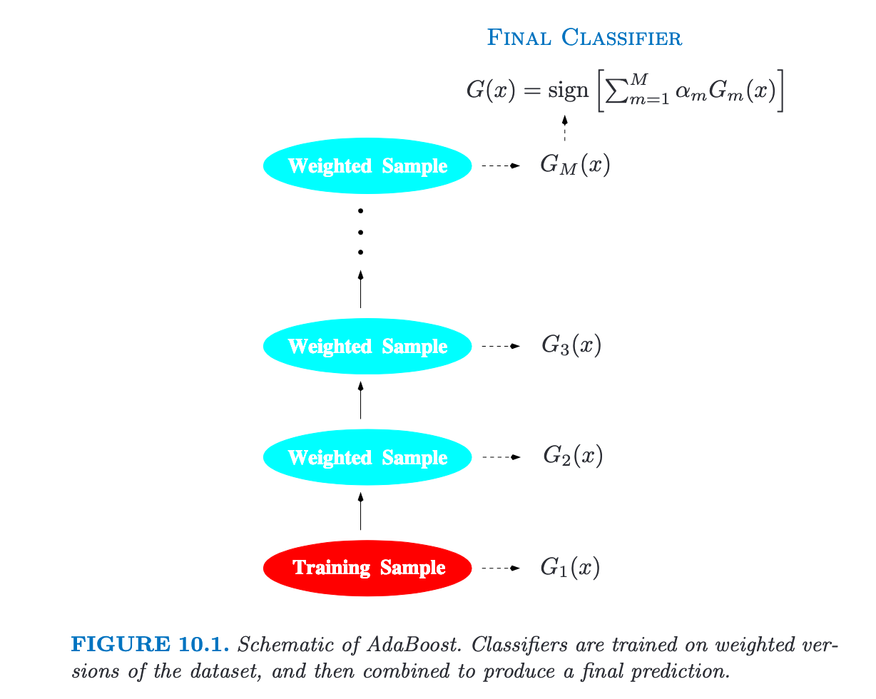
Figure for AdaBoost

Slide 34
Initial Distribution of Data
Train model
Error of model
Coefficient of model
Update Distribution
Final average
Theorem: training error drops exponentially fast
http://rob.schapire.net/papers/explaining-adaboost.pdf

Slide 35
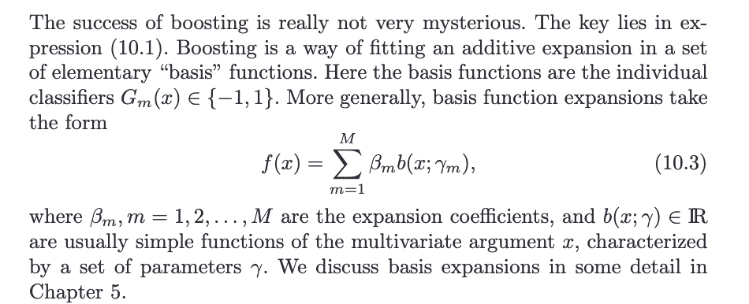
Boosting fits an additive model

Slide 36
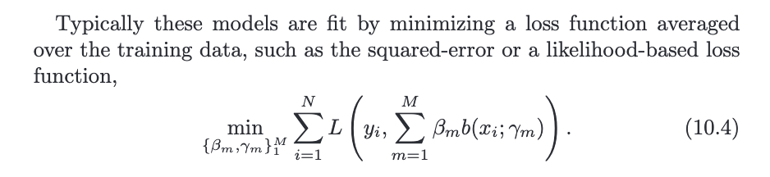
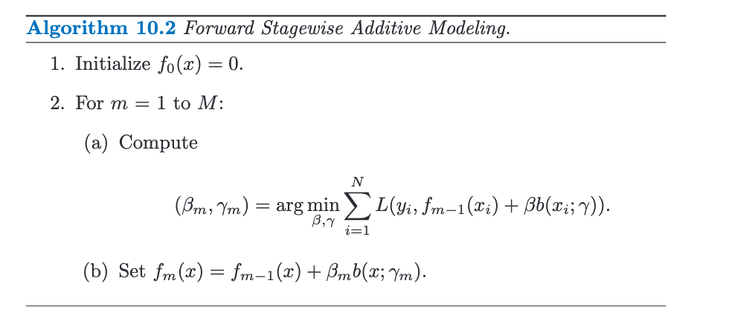

Slide 37
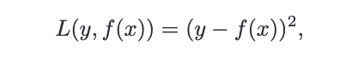
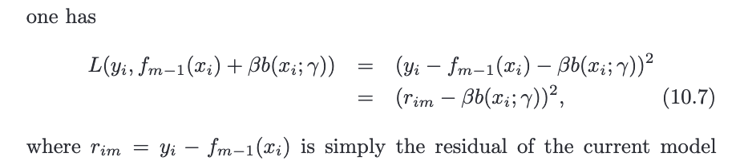
Boosting for regression

Slide 38
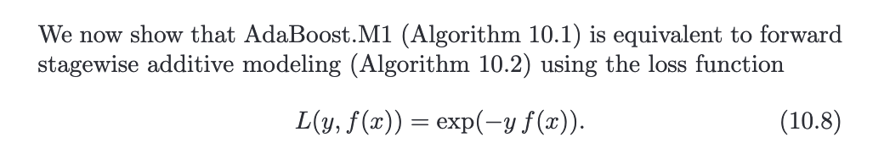
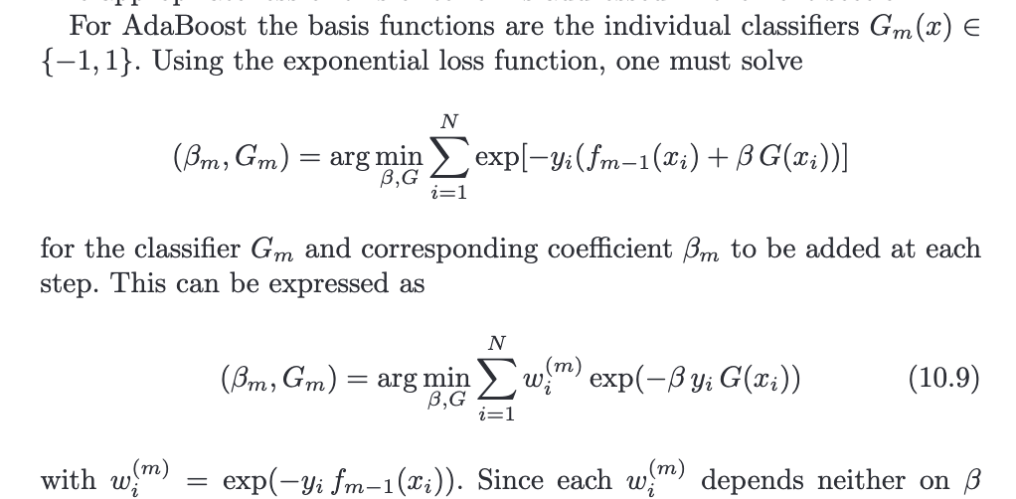
AdaBoost with exponential loss

Slide 39
Why does boosting work?
AdaBoost can be understood as a procedure for greedily minimizing the exponential loss over T rounds:
Why?
where
“Prediction games and arcing classifiers” [Leo Breiman, 1999]
https://www.stat.berkeley.edu/~breiman/games.pdf
Notes:
L(h) = \sum_{i=1}^m \ell(y_i, h(\mathbf{x}_i)) = \exp(-y_i h(\mathbf{x}_i))

Slide 40
Interpretation of Adaboost
Choosing the first classifier
Update at round t
Notes:
(\alpha_1, \hat{h}_1) = \argmin_{\alpha, h} \sum_{i=1}^{m} \ell(y_i, \alpha h(\mathbf{x}_i)) = \argmin_{\alpha, h} \sum_{i=1}^{m} \exp(-y_i \cdot \alpha h(\mathbf{x}_i))
(\alpha_t, \hat{h}_t) = \argmin_{\alpha, h} \sum_{i=1}^{m} w_i^{(t)} \ell(y_i, \tilde{h}_{t-1}(\mathbf{x}) + \alpha h(\mathbf{x}_i)) = \argmin_{\alpha, h} \sum_{i=1}^{m} w_i^{(t)} \exp(-y_i \cdot (\tilde{h}_{t-1}(\mathbf{x}) + \alpha h(\mathbf{x}_i)))
\tilde{h}_{t-1}(\mathbf{x}) = \sum_{\tau=1}^{t-1} \alpha_\tau \hat{h}_\tau(\mathbf{x})
(\alpha_t, \hat{h}_t) &= \argmin_{\alpha, h} \sum_{i=1}^{m} \ell(y_i, \tilde{h}_{t-1}(\mathbf{x}) + \alpha h(\mathbf{x}_i)) \\
&= \argmin_{\alpha, h} \sum_{i=1}^{m} \exp(-y_i \cdot (\tilde{h}_{t-1}(\mathbf{x}) + \alpha h(\mathbf{x}_i)))

Slide 41
Interpretation of Adaboost
Correcting the label for misclassified points
Giving those points higher weights when training classifier in future iterations
We will solve h and 𝛼 separately
Notes:
(\alpha_t, \hat{h}_t) &= \argmin_{\alpha, h} \sum_{i=1}^{m} \exp(-y_i \cdot (\tilde{h}_{t-1}(\mathbf{x}_i) + \alpha h(\mathbf{x}_i))) \\
&= \argmin_{\alpha, h} \sum_{i=1}^{m} \underbrace{\exp(-y_i \tilde{h}_{t-1}(\mathbf{x}_i) )}_{w_i^{(t)}} \exp(-y_i \cdot \alpha h(\mathbf{x}_i)) \\

Slide 42
Solving for h
Fix 𝛼,
Notes:
\hat{h}_t &= \argmin_{h} \sum_{i=1}^{m} w_i^{(t)} \exp(-y_i \cdot \alpha h(\mathbf{x}_i)) \\
&=

Slide 43
Solving for 𝛼
Now solve for 𝛼

Slide 44
AdaBoost weight update
Putting things together,
Therefore, weights for next round are
Notes:
\DeclareMathOperator*{\argmin}{arg\,min}
\usepackage{dsfont}
\hat{h}_t = \argmin_{h} \underbrace{ \frac{1}{\sum_{i=1}^{m} w_i^{(t)}} \sum_{i=1}^{m} w_i^{(t)} \mathds{1}[h(\mathbf{x}_i) \neq y_i ]}_{\text{err}_{\hat{h}_t}} \qquad \qquad
\alpha_t = \frac{1}{2} \ln \left(\frac{1-\text{err}_{\hat{h}_t}}{\text{err}_{\hat{h}_t}}\right) \\
\tilde{h}_{t}(\mathbf{x}) &= \tilde{h}_{t-1}(\mathbf{x}) + \alpha_t \hat{h}_{t}(\mathbf{x}) \\
w_i^{(t+1)}&= \exp(-y_i \tilde{h}_{t}(\mathbf{x}_i) ) = \exp(-y_i \tilde{h}_{t-1}(\mathbf{x}_i)) \cdot \exp(-\alpha_t y_i \hat{h}_{t}(\mathbf{x}_i) )
w_i^{(t+1)}%&= \exp(-y_i \tilde{h}_{t}(\mathbf{x}_i) ) \\
&= \exp(-y_i (\tilde{h}_{t-1}(\mathbf{x}) + \alpha_t \hat{h}_{t}(\mathbf{x})) \\
&= \underbrace{\exp(-y_i \tilde{h}_{t-1}(\mathbf{x}_i))}_{w_i^{(t)}} \cdot \exp(-\alpha_t y_i \hat{h}_{t}(\mathbf{x}_i) )

Slide 45
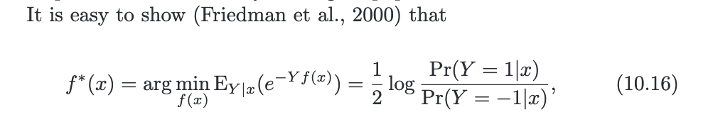
Why do we care about exponential loss?
Fisher consistent loss

Slide 46
Gradient boosting
Consider a generic loss function
E.g. squared loss, exponential loss
Given current predictor , we aim to find new predictor h(x) so that the sum pushes the loss towards its minimum as quickly as possible
Gradient boosting: choose h in the direction of the negative gradient of the loss

Slide 47
Gradient boosting
Fit a model to the negative gradients
XGBoost is a python package for “extreme” gradient boosting
Folk wisdom: knowing logistic regression and XGBoost gets you 95% of the way to a winning Kaggle submission for most competitions
State-of-the-art prediction performance
Won Netflix Challenge
Won numerous KDD Cups
Industry standard
Willett & Chen (2020). “CMSC 35400: Machine Learning”

Slide 48
Method | Minimize Bias? | Minimize Variance? | Other Comments
Bagging | Complex model class. (Deep DTs) | Bootstrap aggregation (resampling training data) | Does not work for simple models.
Random Forests | Complex model class. (Deep DTs) | Bootstrap aggregation + bootstrapping features | Only for decision trees.
Gradient Boosting (AdaBoost) | Optimize training performance. | Simple model class. (Shallow DTs) | Determines which model to add at run-time.
Ensemble Selection | Optimize validation performance | Optimize validation performance | Pre-specified dictionary of models learned on training set.
…and many other ensemble methods as well.
State-of-the-art prediction performance
Won Netflix Challenge
Won numerous KDD Cups
Industry standard

Slide 49
References & acknowledgement
Hastie et al. (2009). “The Elements of Statistical Learning”
Ch 10.1 , “Boosting Methods”
Ch 10.4, “Exponential Loss and AdaBoost”
Willett & Chen (2020). “CMSC 35400: Machine Learning”
Yue (2018). “Machine Learning & Data Mining”
Lecture 5, “Decision Trees, Bagging & Random Forests”
Schapire (2013). “Explaining AdaBoost”
http://rob.schapire.net/papers/explaining-adaboost.pdf

